Slide 1



CFLD NUS Innovation Challenge
Team: Fantastic 4
Debosmita Chaudhuri Mayank Khanna
Rahul Gupta Swetha Narayanan
Notes:
Good morning
We are team Fantastic 4. My name is Mayank Khanna, and these are my colleagues, Debosmita Chaudhuri and Swetha Narayan. The 4th member of our team, Rahul Gupta, couldn’t be with us today because of Personal commitments. So let’s begin!

Slide 2
CFLD Industry City – The Future Begins Today
UP Sub-Region (Noida Ex.) Jahangirpur and Jewar
Factor Selection
Domain Knowledge
Notes:
CFLD Industry city- The Future begins today!
Today we are not just going to tell you where to build the next CFLD Industry city, but also convince you, WHY, that place should be India, and more specifically, New Delhi NCR.
We hope, that by the end of our presentation, you will go from “Why New Delhi- NCR?” to “Why not, New Delhi- NCR?”.
Our solution is marriage between domain knowledge, creative thinking and technical innovation.
We recommend Jewar and Jahangirpur, two town, approximately 50 km north of New Delhi as the location for the next CFLD Industry City.
But what makes these towns so special? How did we reach this conclusion?

Slide 3
Contents
Why India? Vision 2022
Why NCR?
Understanding the Market
Hunt for the next Smart City
Results and Recommendations
Notes:
In the subsequent slides, our team will highlight our creative approach and convince you that our recommendation has Immense Business value.

Slide 4


Why India?
New India Manthan
Vision 2022
Notes:
But, before anything else, we want to tell you what makes India so special, and more specifically, why this is the right time to enter the Indian Market.
We have a stable and Pro-Growth government at the centre that has a vision. “New India”- Vision 2022
In the past 3 years, the government has taken numerous measures to promote growth in India, 2 of which are especially important.
The Make in India
Smart city Mission

Slide 5
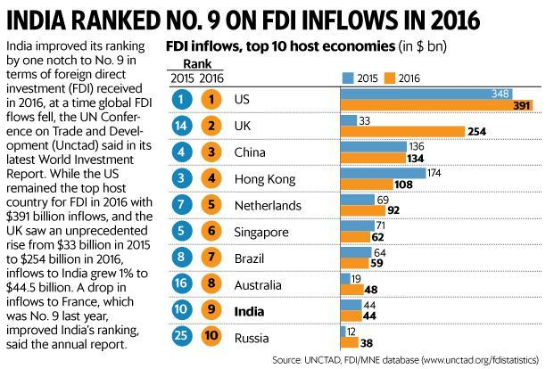
Make in India
Vision: Attract both capital and technological investment in India and make India the top destination globally for foreign direct investment
FDI cap increased from 26% to 49%
Increase in capital inflow by 48% since launch of the Make in India Initiative
Notes:
Read slide

Slide 6
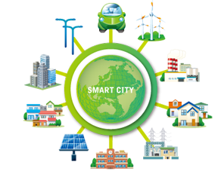
Smart City Mission
Strategic Components:
City Improvement (retrofitting)
City Renewal (redevelopment)
City extension(greenfield development)
$1.1 billion allocated for 150 smart cities.
Business Opportunity: Greenfield development and implementation of smart solutions in previously vacant land Pockets (~250 acres)
Notes:
Smart city Mission- A concentrated effort for Infrastructure upgradation and development of new industry cities.
The government has allocated $1.1 billion for greenfield development and implementation of smart solutions in previously vacant land pockets.
And this is where the opportunity lies.

Slide 7
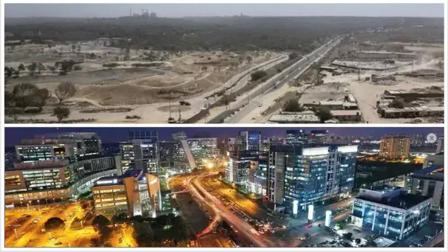
The NCR Story
Fast developing
Barren Land to Industrial Hub
Trunk infra cannot be taken for granted in India
Notes:
A lot of these smart cities are planned in NCR.
Now, before going further, we must first understand what makes New Delhi- NCR so unique.
We must understand the real estate market we want to operate in.
What is the life cycle of a city in India? What are the factors that are vital for the growth of a city?
In India, unlike other countries, the trunk infrastructure cannot be taken as granted.
Historically, Industrial growth drives the development and urbanization of a city.
Explain Slide 8.
Barren land -> Industrial City
Gurgaon before and after.
Only thing available before was good infra.
Differentiates India from other markets where base level development is already present everywhere
Public-Private Partnership

Slide 8
Industrial city Life cycle
Declaration of a city
(Land Use definition)
Connectivity and Trunk Infrastructure
(Highways, roads, Electricity, Canals, Storm water drains )
Arrival of Industry
(Factories, Offices, Business Parks)
Development of Residential Infrastructure
( Condos, Apartments )
Development of Education and Health care Amenities
(Schools, Hospitals )
Development of commercial Infrastructure
( Malls, Theatres, Amusement parks )
Notes:
Historically, Industrial growth drives the development and urbanization of a city.
After a city is declared and the government builds the trunk infra like….
Industry enters the city.
The inflow of working people into this new city creates a demand for residential Infra and subsequently education and health amenities.

Slide 9
Gurugram- An NCR success story
DLF acquires land in Gurgaon
Haryana creates Gurgaon on the outskirts of Delhi
Maruti Suzuki sets up production in Gurgaon
DLF starts development
India opens doors to FDI
GE opens Corporate office in Gurugram
1997
1991
1981
1980
1979
Notes:
Across India, there are several cities that followed the same growth plan, but one city that stands out is Gurugram, formerly known as Gurgaon.
Explain Slide 9, 10.
In 1980, Haryana creates Gurgaon on the out skirts of New Delhi
In 1981, Maruti Suzuki sets up shop in Gurgaon, along with allied industries and ancillary units.
This increased the influx of people coming to Gurgaon daily created a demand for the residential infrastructure.
But the biggest boom came in 1991, when India opened its doors to FDI.
In 1997, GE opened its first corporate office in India, followed by other giants like Lanco Siemens.

Slide 10
And the rest is history…
Exponential Population Increase from 870k in 2001 to 1.5m in 2011
50% of Fortune 500 Companies
40% of the state's revenue – The Golden Goose
Highest number of professional workers per square kilometre
3rd highest per capita income level
Notes:
And the rest is History…..
Gurgaon’s population has increased from 870 thousand in 2001 to 1.5 million in 2011
It is the home…
Contributes…
Has the 3rd highest…
Highest number of professionals per km

Slide 11
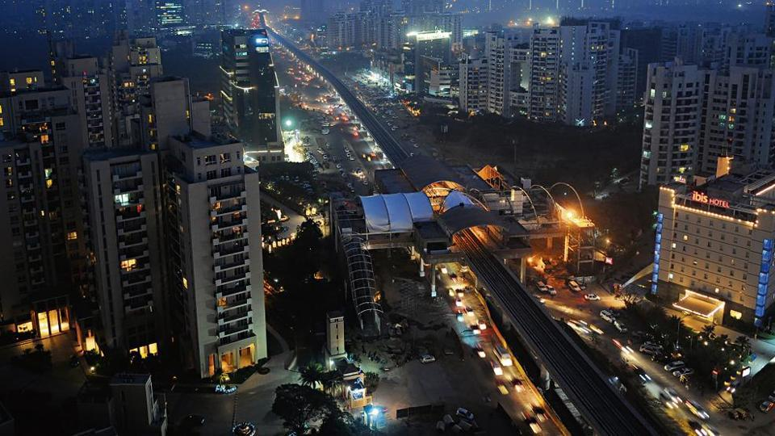
Truly, a millennium city!
Notes:
It is truly a millennium city, and I am also proud to call it my home
Although, Gurugram took 20 years to become what it is now,
We believe, that with the aggressive growth measures and policy implementations of the government
The next Gurugram will come up within the next decade.
So, now, my colleague Debosmita will walk us through the approach to find the next millennium city!

Slide 12
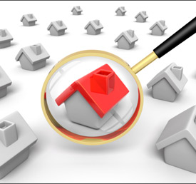
Understanding the Market
Subjective and comprehensive market research before diving into data
Based on reports by
ICICI Bank
Colliers
Proptiger
Economic Times
Regional and Sub-Regional Plans by Government
Notes:
Thanks Mayank. So yes, the aim of the challenge here, as we saw it, was to find the next possible Gurgaon, the next Golden Goose.
Now before we jumped in with the data and the models, its very important to acquire some domain knowledge about the market that we are tackling
For this purpose we invested a lot of time into subjective research of the real estate market of NCR and future development proposals in the area, using government as well as private resources. Let’s discuss some of our findings at this stage.

Slide 13
Administrative divisions of India
Target Area!
Cities are densely populated and Urbanized
Village land is undervalued and sparsely populated
Villages have large pockets of land
Unavailability of land in the cities
Challenge: Data!!!!
Village
State
Zones
Tehsil
District
Country
Municipality
Notes:
India’s administrative breakdown goes from Country at the top to State, District, Tehsils, which are like areas within the districts to the most granular level – Municipalities in urban areas and Villages in rural areas.
Data is obviously more abundant at higher levels like State or District.
However doing an analysis at this level wouldn’t really serve our purpose of selecting a precise area to invest in.
So we went ahead with an ana
We want to focus on most granular level to avoid heterogeneity issue at district level

Slide 14
Projects to watch out for – Public Private Partnership
Government Projects
Delhi- Mumbai Industrial Corridor center for Urban Research
2800 MW Nuclear Power plant- Haryana
Second International Airport in Jewar
Noida-Agra monorail link
Water Supply Scheme- Faridabad (Augmentation)
IT Park (Gateway Tower)- Faridabad
IT Park (Business Bay)- Faridabad
Cold Chain Facility- Sonipat
Business Projects
Ireo Special Economic Zone (SEZ)- Sohna Town
Patanjali Manufacturing facility
Vivo smart phones manufacturing
Oppo smart phones manufacturing
Toyota Motor corp
Daikin Industries
Notes:
The second important understanding from our research was around where is the Government and other private focus moving.
Development cannot happen in isolation, and Public-Private Partnership is especially important when it comes to undertaking projects at such huge scale.
So understanding the general focus areas is an important step before we move forward with our analysis

Slide 15
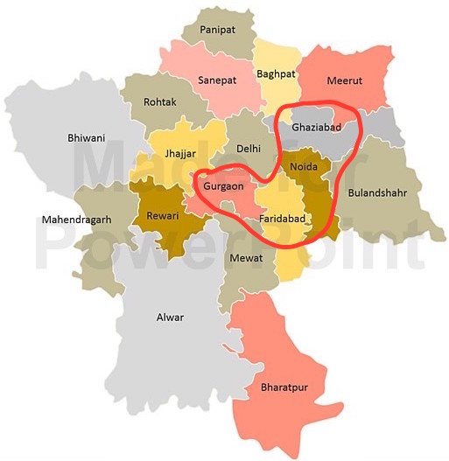
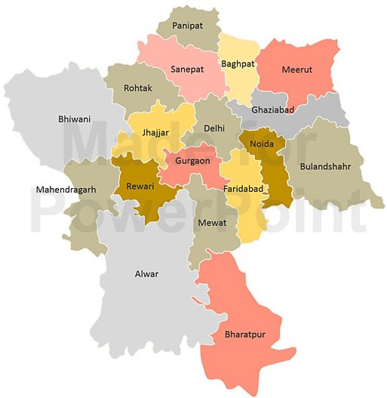
Selecting focus areas
Business Focus
Developers
Industries
Government Focus
Special Economic Zones (SEZs)
Connectivity
Notes:
We narrowed down our domain of analysis and selected the areas to focus on using the knowledge of government focus, like where are the new special economic zones coming up, where are the new expressways, MRT stations and airports being planned, and also where are other private developers and industries interested in
We decided to focus on the Uttar Pradesh and Haryana sub-regions of NCR, especially the areas of Gurgaon, Faridabad, Greater Noida, Noida and Ghaziabad for our analysis.

Slide 16
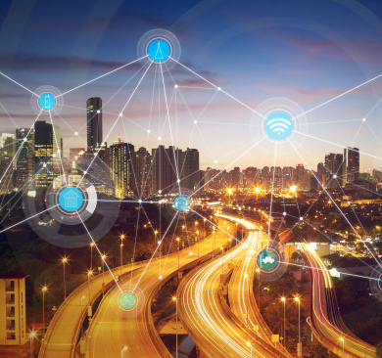
Hunt for the next Smart City
An Analysis on Selected Focus Areas of NCR
Notes:
With this extensive research in place we moved on towards a technical analysis to find out the best location for the next smart city

Slide 17
Analysis Methodology
Data Collection & Preparation
Data cleaning
Exploratory data Analysis
Random Forest
Elastic net
Variable importance
Random Forest
Elastic net
Splitting data into test and training set
Bi-variate plots
Model Building
XGBoost
Created Price buckets
Location Recommendation
Identified location with maximum growth potential
Notes:
We followed a standard roadmap for this analysis which began with data collection and preparation. Obviously this wasn’t an easy job and we had to come up with innovative and ingenuous proxies for the factors that we believed were relevant but not readily available. This was followed by some exploratory analysis. Then we needed to come up with creative modeling approaches that helped us understand important contributing factors as well as predict future trends accurately. Using the results from these models and our subjective understanding of the domain we arrived at our final recommendations.

Slide 18
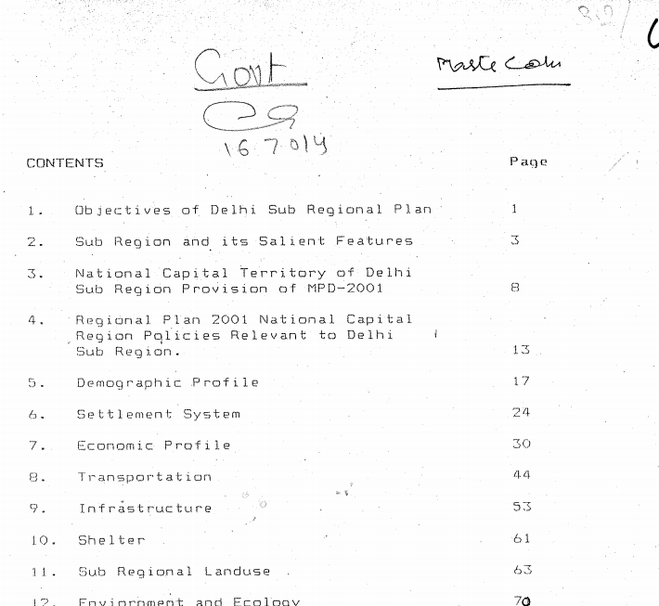



Major Challenge- Data Collection!
Data Collection and Preparation
Data Exploration
Variable Importance
Modelling
Results
Village level data needed for acute analysis
Data collected manually from government reports
Multiple data sources
Different data granularity at different sources
Heterogenity in District Level Data
Notes:
The toughest challenge in this whole process turned out to be data collection.
Data maturity in the Indian market is relatvely low.
Some data is only available in the form of pdf reports, and worse still some of them are actually scanned copies of physical reports like the example shown here.
This meant a lot of manual effort went into interpreting these.
Also different data are available in different granularities and for different time frames, so normalizing all of it sensibly involved a lot of effort.

Slide 19
Data Collection and Preparation
Data Exploration
Variable Importance
Modelling
Results
Government Sources
Regional and Sub-regional Plans for NCR
Functional Transport Plan
Functional Plan for Economic Development
Forest Survey of India
Department of Agriculture and Cooperation
Ministry of Micro, Small and Medium Enterprises
Census 2001,2011
Department of Economic Affairs
Commercial Sources
99acres.com
Numbeo.com
Makaan.com
Google Maps
Magicbricks.com
Research/News Sources
Colliers Real Estate Research Report
ICICI NCR Real Estate Analysis
Economic Times
Notes:
We sourced data from Government, Commercial as well as other Private Research Sources to make sure that we capture a holistic perspective
After thinking of the possible relevant factors we had to hunt around for innovative sources for the same,
eg. Land use trends is obviously an important factor but not readily available anywhere, so we had to get creative.
However we can proxy these using forest land area changes as reported by the forest survey or agricultural land area changes by the dep of agriculture.
Similarly ease of doing business is not an easy metric to capture but we can proxy it using the trends in industrialisation reported by the ministry of micro, small and medium enterprises.
Residential prices sourced from commercial real estate sites were used as a proxy for land value in the different areas.
We combined online scraping along with manual scavenging to gather all this data. Without automated scraping the process of gathering data would have slowed down more than 5 times.
A pivotal step here was to convert subjective data into tabular quantitative data by creating binary variables or some scoring systems

Slide 20










Extensive Data cleaning & Feature Engineering
Data Collection and Preparation
Data Exploration
Variable Importance
Modelling
Results
Data sourcing
Web Scraping, Price, Village-wise area demographics, Existing Infrastructure, Government reports and livability indices
Data cleaning and feature engineering
Input missing values, cleaning price data, getting distances from airport
e.g. Land Use, Industrialisation, Development indicators
Data consolidation and Exploratory analysis
Notes:
After collecting data from diverse sources, the next challenge was to massage and manipulate these to generate sensible features.
Eg if we want to capture the rate of change of land use, we should use a time window that makes sense.
Same goes for creating industrialisation or development oriented features
Significant effort was also spent in normalizing the data to comparable granularity.

Slide 21
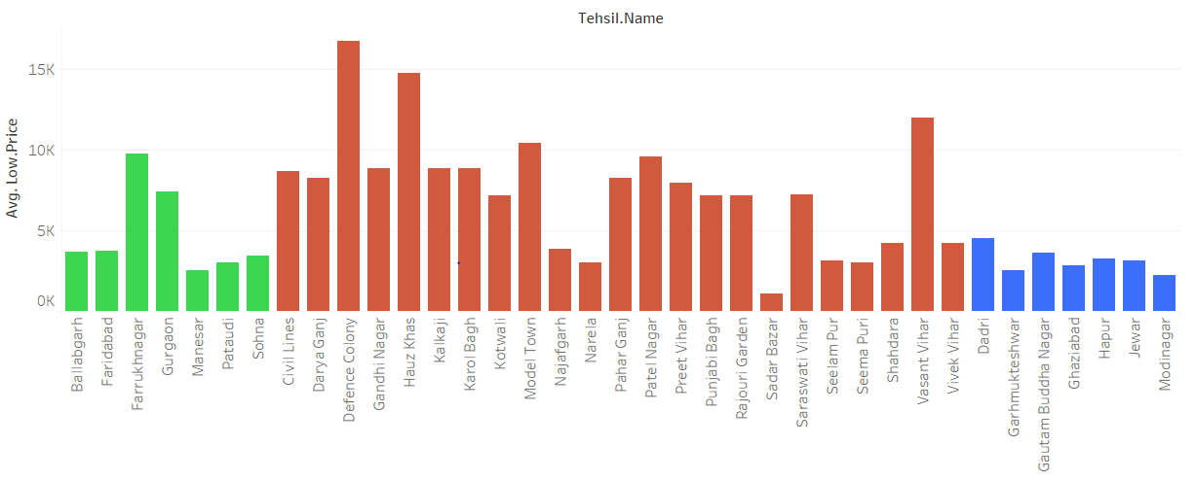
Data Exploration- Price comparison in the 3 subregions
Data Collection and Preparation
Data Exploration
Variable Importance
Modelling
Results
Haryana
New Delhi
Uttar Pradesh
Notes:
Next step was some preliminary exploration to understand general trends.
A simple price comparison shows that the central Delhi is already pretty saturated and overvalued, so there’s probably not a lot of value in entering here.
However the surrounding Haryana and Uttar Pradesh sub-regions show potential for growth. Uttar Pradesh to the right looks especially undervalued.

Slide 22



Variable Selection
Data Collection and Preparation
Data Exploration
Variable Importance
Modelling
Results
Explains Residential Prices
Predict Future Potential
Land Use
Industrialization Indicators
Working Population
Lagged demographic and household trends
Drinking water, Drainage, Electricity
Low
Importance
High
Importance
No of Malls, Schools, Theatres, Hospitals
Crime Rate
Air Quality
Connectivity
Notes:
The next step is to select carefully the features that will go in our model. This step is actually where our creative thinking kicked in.
In a real estate problem like this we can do two things, either explain current residential prices or predict future land potential.
Now some variables that are often used in real estate problems are indicators like number of malls, schools, theatres, hospitals and other facilities.
While these variables really explain current prices very well, because this is what you and I would look for when buying a house today, they are not relevant at all in predicting future land potential for building a new smart city. Not in India at least. Like Mayank has already explained a smart city building process in India starts from a patch of completely barren land, with some very basic facilities like trunk infrastructure, electricity, drinking water, availability of labour etc. So these features, shown here to the right, are the more important factors that need to go in our model apart from other variables like land use trends, industrialization trends and working population migration trends which indicate how fast development has been reaching these areas and helps proxy the Government’s interest in development too.
So to begin with, we eliminated the features to the left, that is no of malls, schools, hospitals etc. We left these information out so that they do not confound our models and focused on the variables to the right.
Livability indicators like crime rate, air quality and connectivity were also used in the model.

Slide 23
Model Building
Data Collection and Preparation
Data Exploration
Variable Importance
Modelling
Results
Elastic Net
Linear model with regularization
Random Forest
Many decision tree models grown in parallel
XG Boost
Ensemble of trees grown sequentially
Each tree is independent of the outcome of the other trees.
Efficiently weeds out less important variables
Each tree learns from previous one’s mistake
Selected Predictive Model
Accuracy
Interpretability
Notes:
Next step was to select the perfect model for the job.
We decided to work with three types of machine learning models, elastic net, random forest and Xgboost.
In the interest of time, I will not go into the technical details of these models right now but only talk about how we used them.
So in this problem we had two goals – one is to understand the important factors correctly and the other is to predict future value accurately.
We decided to use the first two types of models, elastic net and random forest to first understand the most important variables explaining land value.
These models are more interpretable, meaning the results can be understood easily by humans, so they were perfect candidates for explaining the important factors.
Once we have understood the important factors, we went on to a 3rd more sophisticated kind of model, called Xgboost to predict the future trends in land value.
Now this model, although way more accurate, is not very interpretable. However that was not a problem, as long as we could verify that the variable importance being suggested by this model is roughly similar to the previous two.
Also using three independent models meant that we could cross check their results against each other and ensure the robustness of our results.

Slide 24
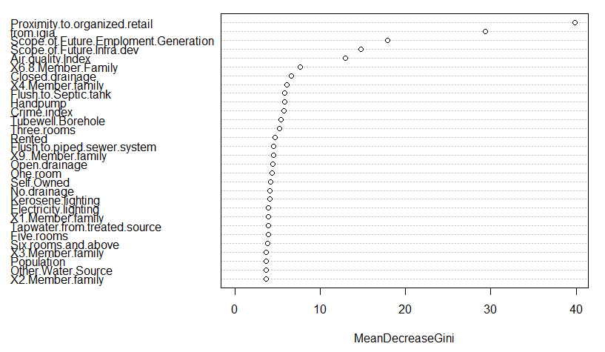
Final Models & Highlights
Data Collection and Preparation
Data Exploration
Variable Importance
Modelling
Results
Village level granular Analysis
Creative proxies for relevant features
Variable Importance
Cross Validated with 2 different models
High accuracy prediction of current price buckets
Training and test data sets
Future Price Trends
Change Data points
Distance from airport
Future Employment scope
Future Industrial Investment
Future Infra Development
Variable Importance Curve
Notes:
This brings us to an overview of the final models that we built.
To reiterate the highlights – we conducted a village level granular analysis, we used creative and innvoative sources to proxy relevant and practical features.
We used two separate kinds of models to cross validate the importance of our variables
Of course we split the dataset into training and test sets to validate the accuracy of these models.
After being confident that both these models are resulting in similar variable importances, we went ahead with out predictive xgboost model.
To predict the future we basically updated certain variables with their estimated future values
Eg distance from the airport was updated to be the distance from the nearest airpot after the new planned airport comes up in the next 5 years.
Or the planned employment generation, industrial investment and infrastructure development over the next 4 years as reported in the Government’s economic development plan

Slide 25
Final Results on Test Data
Data Collection and Preparation
Data Exploration
Variable Importance
Modelling
Results
Confusion Matrix
Predicted price bucket | Actual Price Buckets
 | 0-5000 | 5000-10000 | >10000
0-5000 | 73 | 1 | 0
5000-10000 | 2 | 23 | 0
>10000 | 0 | 0 | 6
Final XG Boost model run on current test data gives phenomenal results!
Predictive accuracy on Test data set: 97.14%
Notes:
Our factor importance models showed a really good accuracy of over 95%.
Since our predictive xgboost model also suggested the same important variables as the previous two, we are confident about the performance of these predictions.
My colleague Shweta will now talk about the final results and recommendations of our analysis.

Slide 26

Results and Recommendations
An Analysis on Selected Focus Areas of NCR that will add business value for CFLD
Notes:
Thanks Debo. Now ONTO the final part of our presentation! We will now present our model results and recommend the key focus locations in Delhi which will add huge business value for CFLD.

Slide 27






Factors that contribute to Land Value of NIC
Distance from airport
Working and skilled population
Connectivity and infrastructure
Sewer system
Availability of treated water
Livability – Air quality and crime
Electricity availability
Notes:
From our model, we get 7 factors which contribute significantly to land value.
Let’s go through the factors.
Distance from the nearest airport
Availability of electricity and power
Is there skill manpower?
How well connected is the place in terms of road, railway and air transport infrastructure
Is there a well-maintained sewer system ?
Is there availability of treated water?
And finally, how will the quality of living be – mainly in terms of air quality and crime rate
To build a new industry city from an almost barren area, it makes sense that these factors are the most likely to contribute significantly to increase in land value.

Slide 28
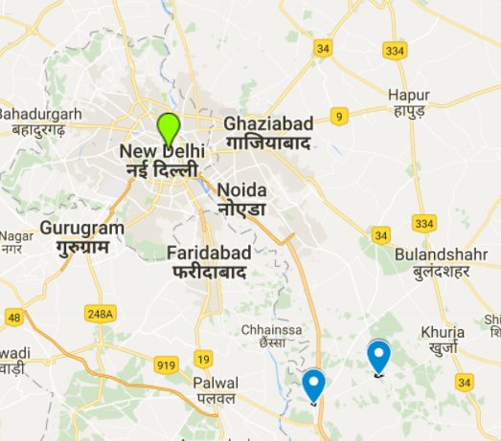
Location recommendations for the CFLD New Industrial City
Noida Extension Jahangirpur Jewar
Yamuna Expressway
Greater Noida
Faridabad
Notes:
Based on the key factors highlighted before, we obtained data for future planned projects that will help in our goal to find the next new industry city. We found that the Govt has recently invested in the development of a new airport in Jewar. Further Jewar is well connected to New Delhi.It has a good working population who can travel to and from New Delhi as well.
So we input this new data into our Boosting model and we obtained 2 regions in the Noida Extension , namely Jahangirpur and Jewar. These two regions have the highest growth potential.
We also combined this quantitative result with subjective research like Government and industry focus plans in these areas. So apart from these two regions, we predict that the peripheral or the nearby areas of YE, GN and Faridabad are expected to benefit too.

Slide 29
Future change of Land Value- Jewar, Jahangirpur
₹0-5000/ sq ft
More than ₹10000/ sq ft
100% appreciation
2017
2020
2022
Notes:
Our model predicts that in the India Vision 2022 timeline, there will be more than double land price appreciation in the areas of Jewar and Jahangirpur with the buiding of new industry cities in this area.

Slide 30
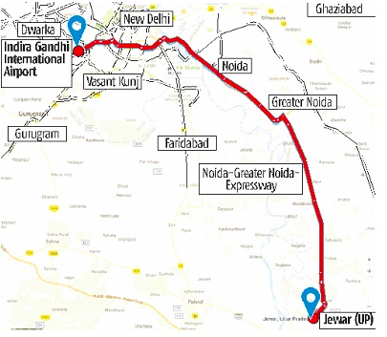
Business Value Proposition for New Industry City in Delhi
Based on extensive research and predictive modelling, we see high potential targets for CFLD in areas of Jahangirpur, Jewar (Noida Extension) and its peripheral areas.
Highways - Excellent connectivity with New Delhi
Greenfield Projects- Airports
Stable and decisive Government
FDI Investments
Availability of highly skilled man power
Factors for NCR Real Estate Growth
Notes:
So to summarize our business value proposition for CFLD is Delhi and in particular the two areas of Jahangir and Jewar.
Good connectivity in Delhi, Greenfield projects like development of new airport, Stable and decisive policy making by the central Government, inflow of Foreign Direct investments and availability of high skilled man power are all the key contributing factors which will drive large scale growth in these regions.

Slide 31
CFLD Industry City – The Future Begins Today
UP Sub-Region (Noida Ex.) Jahangirpur and Jewar
Factor Selection
Domain Knowledge
Notes:
So to conclude, We gained extensive domain knowledge to understand real estate market in India, We took a leaf out of existing success stories to find inspiration for the next new industrial city.
We performed innovative data collection and feature selection eliminated confounding variables.
And finally we used those features and the planning data from Government to predict the areas most likely for CFLD to focus on and bring a change to the Indian real estate market.
Our Recommendations for NCR are areas in UP sub-region like J & J with High Growth Potential
To reach at our conclusion we used a combination of subjective domain knowledge and technical expertise to select the best factors that predict future growth, carefully eliminating development indicators which are highly correlated with present value but do not predict future growth.

Slide 32
Thank you
Notes:
Thank you NUS Business Analytics Center and CFLD for giving us this opportunity to work on this exciting project. And thank you all for being a lovely audience. Hope you enjoyed our presentation. Now we can take any questions ☺

